Slide 1

Wrapping Up with the
Summary of Performance
Jenny Jacobs, TIG TA Specialist and Indicator 14 Coordinator

Slide 2
Learning Objectives
Attendees will identify which students are required to receive a SoP and determine when they will receive it.
Attendees will identify the required components of a Summary of Performance.
Attendees will compare the pros and cons of the documentation options for the SoP.

Slide 3
Summary of Performance is Required
“A public agency must provide the child with a summary of the child's academic achievement and functional performance, which shall include recommendations on how to assist the child in meeting the child's post secondary goals.”
Federal Register Vol. 71 No. 156 300.305(e)(3)

Slide 4

For Which Students?
Students with disabilities
who exit with a regular diploma
who reach the maximum age of eligibility
who earn an HSED and receive a HS diploma

Slide 5
Notice of Graduation
DPI Form P-3
is used to provide the parent and the student with notice of graduation with a regular high school diploma and to provide the student a summary of academic achievement and functional performance
DPI Form P-4
is used to provide the parent and the student with a notice of ending services because of age and to provide the student a summary of academic achievement and functional performance.

Slide 6
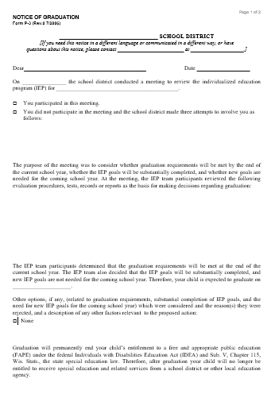
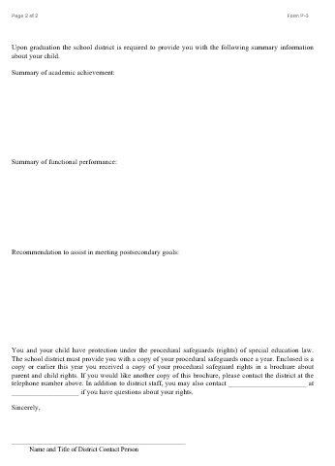
DPI’s P-3 Form: Notice of Graduation
DPI’s P-4 is used for students aging out of the school system

Slide 7
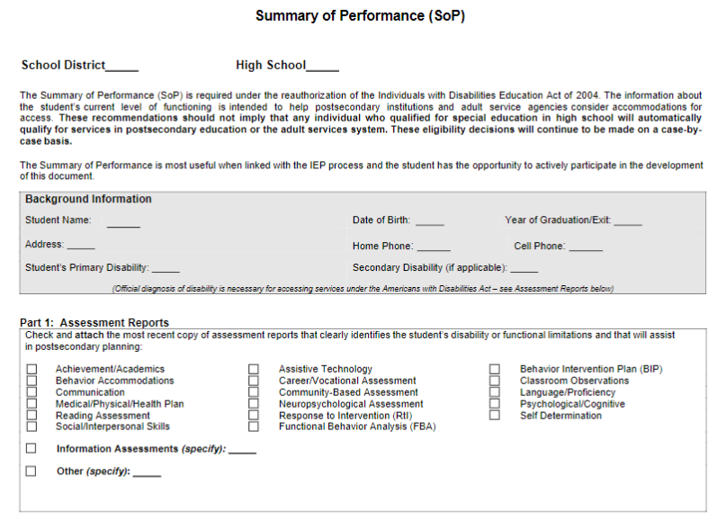
Summary of Performance (SoP)

Slide 8
Summary of Academic Achievement
Address academic areas:
Reading and Language Arts
Written language
Math
Include both grade level and description of skills
Does the student’s disability impact those academic areas? If so, how?
What accommodations, AT and supports were
necessary for the student to achieve the skills
stated?

Slide 9
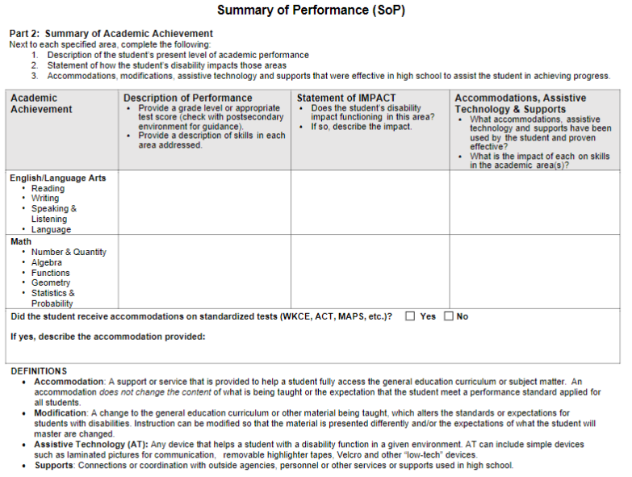
Part 2 Summary of Academic Achievement

Slide 10
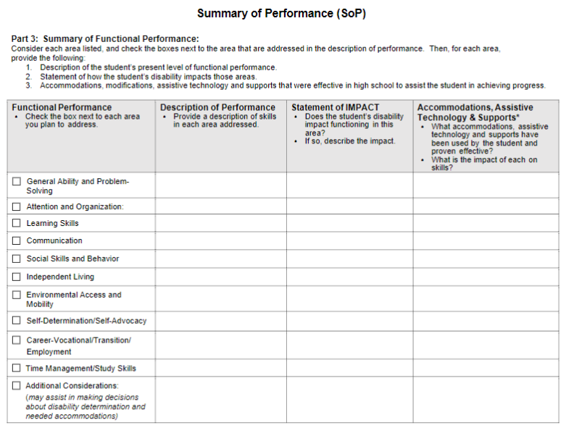
Part 3 Summary of Functional Performance

Slide 11
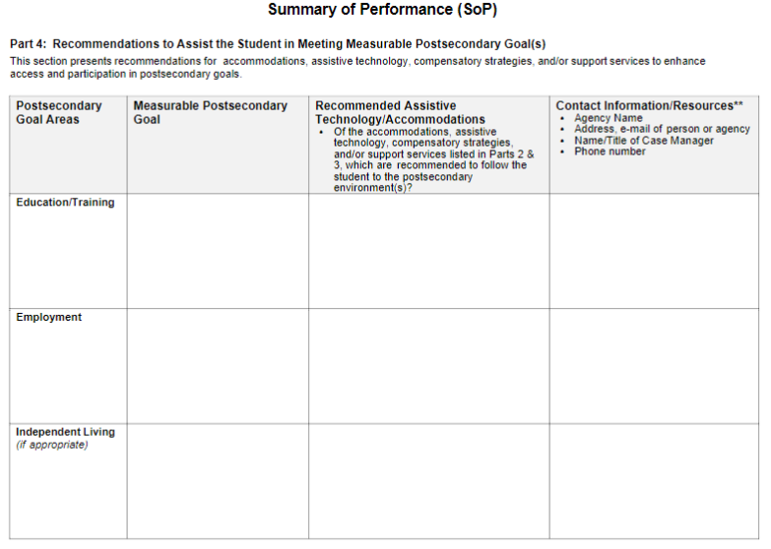
Part 4 Recommendations

Slide 12
Summary of Functional Performance
Select the areas of functional performance you plan to address
Provide a description of skills for each area you have selected
Does the student’s disability impact performance in each area? If so, how?
What accommodations, assistive technology and supports were necessary for the student to achieve the skills stated?

Slide 13
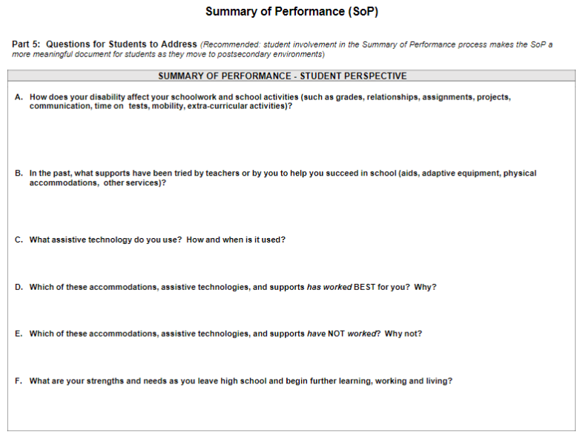
Part 5 Student Input

Slide 14
Forms - Pros and Cons of Use
ZOOM Whiteboard

Slide 15
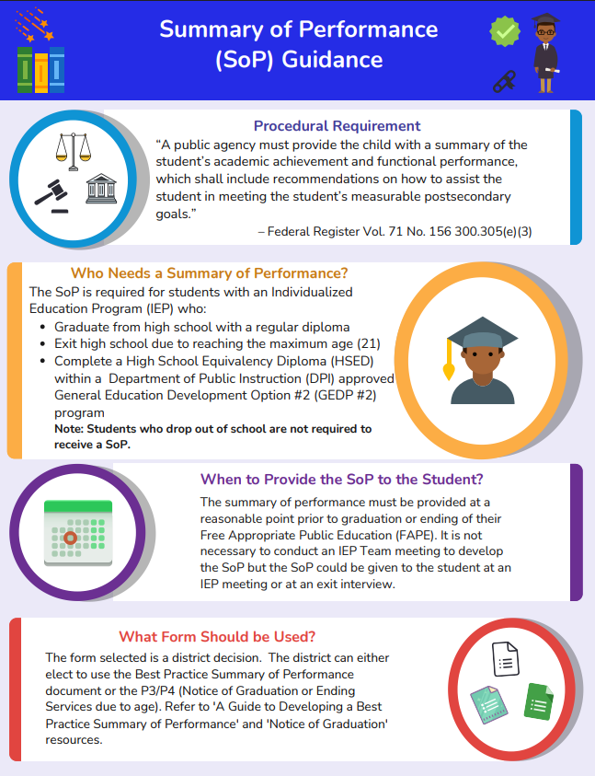
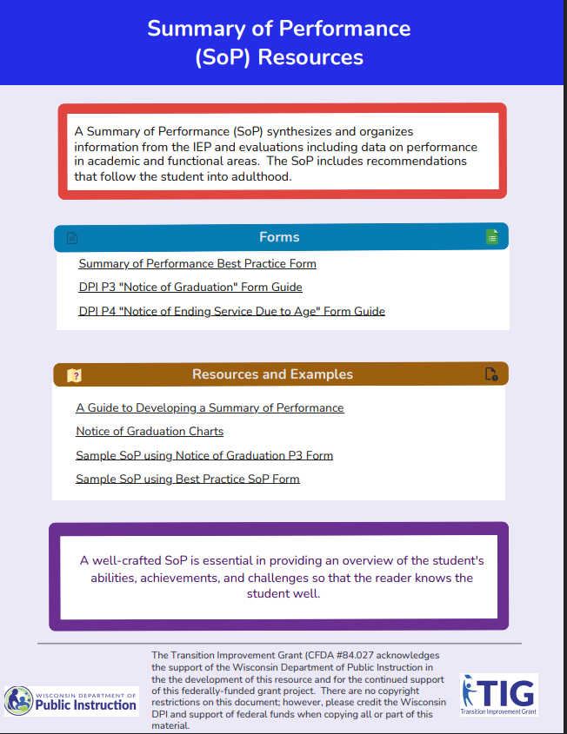
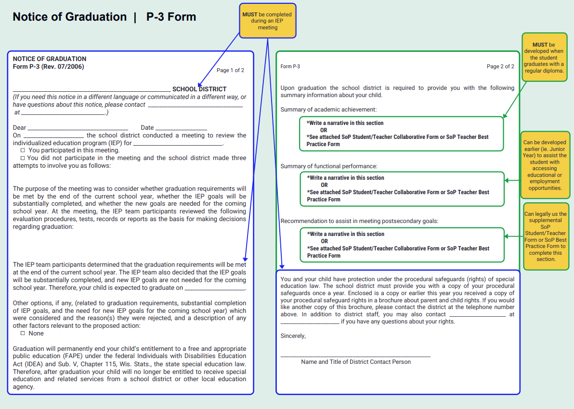
Resources

Slide 16
Disability Documentation
The SoP alone does not satisfy the requirements for documentation of disability.
Contact the postsecondary institution disability services and/or adult service agencies to find out what is needed.
Based on discussions with the postsecondary institution or agency, compile and attach documentation that demonstrates that a disability currently exists.

Slide 17

Contact Us:
Jenny Jacobs
jjacobs@cesa7.org

