Slide 1

Beyond Age 18 Programming: Best Practices, Challenges and Solutions
Alicia Reinhard- Education Consultant on Transition and Graduation- DPI
Shelley Burke Otto - TIG Transition Specialist
November 18, 2025

Slide 2

Welcome
Session Objectives:
Review foundation of providing special education beyond age 18
Technical components of beyond age 18 programming
Common programming design challenges
Questions, Comments, Wonders

Slide 3

Transition Programming Beyond Age 18
TIG Website
Transition Programming Beyond Age 18 Site
PDF of Transition Programming Beyond Age 18

Slide 4
Should and Should Not Be...
Should Be: | Shouldn’t Be:
Available for any student with an IEP as determined by an IEP team. | Based on a disability category.
An IEP team decision. | Decided by an application process.
Individualized and foundation built by student’s IEP and PTP. | A continuation of traditional school day.
Community based focused, post secondary, employment, community belonging. | A self-contained environment and repeat of coursework already completed.

Slide 5
Should and Should Not Be….
Should Be: | Shouldn’t Be:
Supported by braided funding with outside agency support and community resources. | Supported exclusively by school funding.
Mirror a day similar to a student who has left high school in preparation for postsecondary goals. | Mirror a day that works for the school’s schedule and doesn’t support transition goals.
Meaningful, culturally responsive, and relevant for the student. | A defined schedule and program for all students(i.e. Students all take specific courses and stay until 21).
In a natural environment similar to same age peers. | In a segregated setting with school staff supporting.
Supporting coursework/credits needed to graduate or support goals. | Taking classes over to fill in open time in a schedule.

Slide 6

The Importance of Gradual Release
Start conversations early
Steps to reach the end goal
  Write it out~provide examples
Collaboration is key through education
Who we collaborate with shifts
Smooth gradual handoff, no cliff
School supports fade to outside supports
Release happens differently for each student

Slide 7

Program vs Programming
Beyond Age 18 needs to be individualized programming aligned to student disability related needs
IEP Teams should reflect on FAPE as it may shift as students enter Beyond 18
Like services and instruction may be grouped together
  Scheduling is key!
A strong network of partners will allow programming to shift as needs change for your students

Slide 8
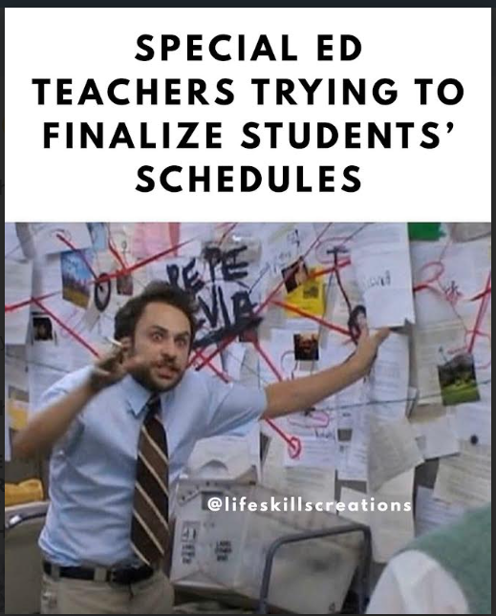
It’s Messy~ But Doable!

Slide 9
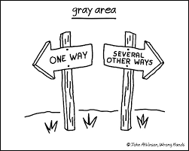
The Gray!
No one set program or curriculum
Individualized programming
  Including students with unique needs
Different resources and supports available
More time to connect and communicate needed
Each school, community, county, team is unique!

Slide 10

Technical Programming Challenges
Individualizing student schedules
Staffing
Transportation
Balancing the schedule with student needs
Environmental codes
  Attendance
Standards

Slide 11

Resources for Technical Challenges
Sample schedules
Transition Action Guide
Environmental Codes
WI Career Readiness Standards
  I can, We Will Implementation Guide
  WCRS Professional Learning Modules
Social Emotional Learning Competencies

Slide 12

Working With Families On Program Design
Families hanging onto school and to 21
Navigating hard conversations
Must start transition conversations early
Behavior is rooted in fear
Communicating more frequently
Keeping ideal day/week in mind. Build the steps to get there.
Traditional vs Non traditional engagement

Slide 13


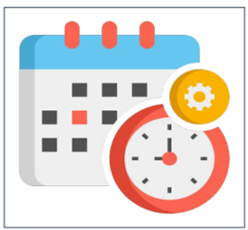

Disengaged or Unreached?
Are we labeling families as disengaged when they are actually unreached?
Are we ensuring information and family engagement is:
Communicated Effectively
Culturally Relevant
Scheduled Considerations
Accessible Location

Slide 14

Resources for Working with Families
Wisconsin Statewide Parent Educator Initiative (WSPEI)
Before Age 18 Website: Action Steps for Families
BPDD Toolkits Resources for Families
DPI Webpage Family Support and Advocacy
Statewide & Community Resources for Families with Children with Disabilities
WI FACETS: Wisconsin Family Assistance Center for Education, Training & Support

Slide 15

Collaboration with Transition Partners
Acknowledge we all care deeply
Braiding services
No to hearing “payee of last resort”
Collaborate with outside agencies
Meeting on neutral ground
  Consider Transition Meetings outside IEP
Think outside the box on transition partners
Transition Action Guide (TAG)

Slide 16
Resources for Collaboration
WIOA Schools-DVR Partnerships
DWD How DVR and School Work Together For Youth
Transition Action Guide

Slide 17
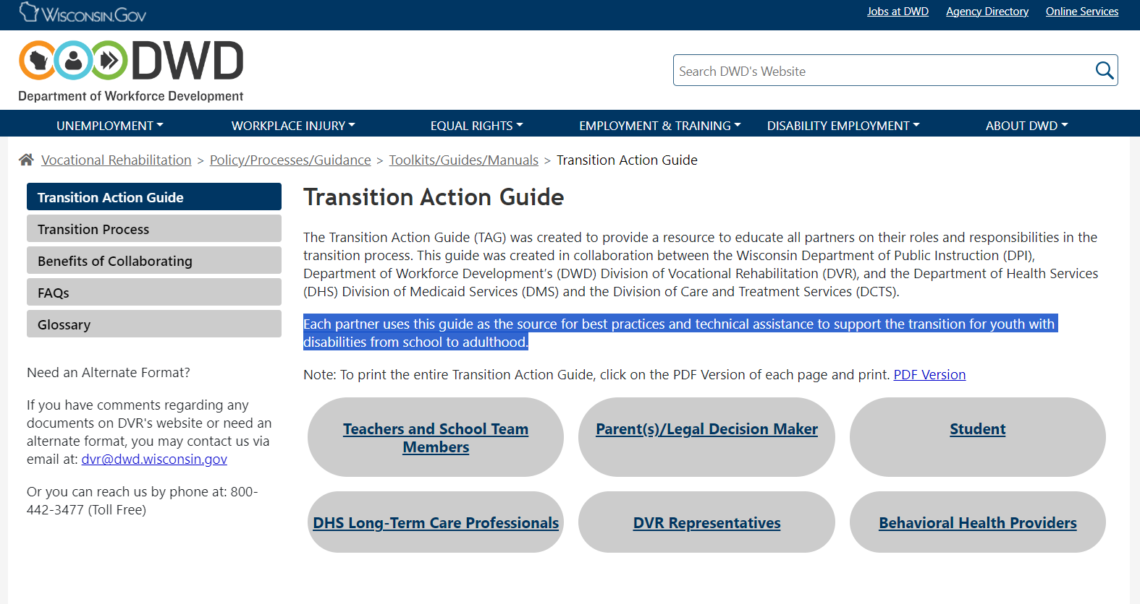
Transition Action Guide
A resource to educate all partners on their roles and responsibilities in the transition process.
Each partner uses this guide as the source for best practices and technical assistance to support the transition for youth with disabilities from school to adulthood.

Slide 18

Conflict Resolution
When IEP teams, families or transition partners don’t agree:
Meeting as a transition team
Backwards planning from student’s ideal day
Student voice
All partners approaching their support with a “yes”
Dispute resolution options

Slide 19
How Do IEP Teams Make Beyond 18 Decisions?
Start conversations early
IEP teams make the individualized decision
  Start with the postsecondary goals
Ensure all the appropriate transition partners at at the table
Regularly revisit programming design
Reminder: there should not be set criteria for accessing Beyond Age 18 services

Slide 20

Questions ~ Comments ~ Wonders

Slide 21


Contact Us
TIG Contact Page Link
Alicia Reinhard
Alicia.Reinhard@dpi.wi.gov
Shelley Burke Otto
SBurkeOtto@cesa9.org

