Slide 1


CCoT Team RESET ~ Introduction
Notes:
Welcome everyone to the meeting

Slide 2
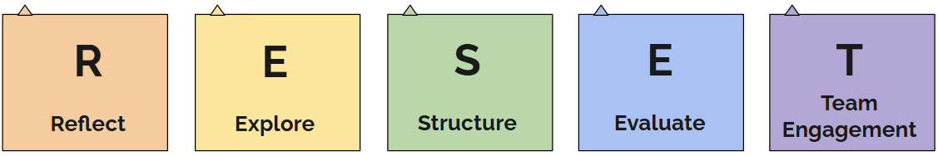
Welcome to the CCoT RESET
Notes:
Welcome to the CCoT RESET Meeting.
In Wisconsin, we have 72 counties—and over the past 20+ years, we’ve seen many different versions of what we now call a County Community on Transition, or CCoT. In the early days, each county had its own CCoT team. But over time, things have shifted. Some neighboring counties with shared transition partners joined forces to create regional CCoTs. In other places, CCoTs may have drifted apart—sometimes due to leadership changes, a lack of purpose, or simply losing momentum.
This presentation is designed to help CCoTs that are looking to start up again—or those that are still meeting, but feel like they’ve lost their way. Either way, this RESET is an opportunity to reflect, explore, structure, evaluate, and re-engage as a team.
Our goal is to rebuild with intention—to come together as a united team with a shared purpose and a clear plan of action. At the heart of this work is our commitment to supporting students with disabilities and their families as they navigate the transition for exit of high school to adulthood. Every member of the CCoT team plays a vital role in that process, and we hope this RESET helps each of us reconnect with our roles, responsibilities, and the collective purpose we share.

Slide 3

Objectives:
Reconnect and re-engage with the purpose of your CCoT team.
Build relationships through intentional partner-to-partner dialogue.
Reflect on team composition and begin identifying gaps in partnerships.
Explore foundational characteristics of effective interagency teams.
Deepen understanding of the role and purpose of a local CCoT.
Learn about WiCoT and how state-level work supports local team goals.
Notes:
Our objectives for today's meeting are: Read slide

Slide 4

Activity
Speed Networking
Tell me about your work and how you support transition.
What are you invested in when it comes to youth in transition?
What transition partners do you connect with to support youth transition?
Notes:
Let's begin today's meeting with getting to know each other a little bit better. A good team that works well together, understand each other and builds trust in one another. Speed networking is an opportunity for team members to connect with one another, share insights about their work , and how they contribute to youth in transition.
Directions: Ask each team member to pair up randomly 2-3 people per group depending on group size
There will be 3 rounds to address each question. Start a timer for 6 minutes-When the activity starts-each person in the group will have 2-3 minutes to answer the questions starting with the first question. After the 1st round of questions, switch partners and move to the second question. Continue until all three questions have been answered and discussed within the teams.
Wrap up: 5-10 minutes. Once all rounds are complete, gather together for a debrief and ask the team:
What did you learn from each other?
Were there any surprises that you did not know about a team member?
What ideas came to mind through this activity of how you can better support each other?

Slide 5

What We Know About Effective Interagency Teams...
Establish and reflect a common mission, vision, and purpose.
Agree on goals that are obtainable.
Hold regular team and work group meetings.
Develop well-planned agendas.
Empower all team members to be active and equal members.
Promote shared decision-making.
Clarify roles and responsibilities of each team member.
Establish mechanism for ongoing communication among all partners.
Developing meeting collective commitments as a team.
Notes:
When we think about what makes an interagency team truly effective, there are a few key practices that consistently rise to the top. Strong teams begin by establishing—and regularly reflecting on—a common mission, vision, and purpose. This shared foundation helps guide all the work that follows. From there, it’s important that the team sets clear, obtainable goals that everyone can work toward together.
Consistent communication is also essential. Effective teams hold regular meetings, both as a full team and in smaller work groups, and those meetings are grounded in well-planned agendas that help keep the group focused and productive. Just as important is the way we engage with one another. Successful teams empower every member to be an active and equal contributor. That means promoting shared decision-making, where all voices are valued, and clarifying the roles and responsibilities of each team member so that everyone knows how they can contribute.
Lastly, effective teams create reliable systems for ongoing communication among all partners. Whether through email updates, shared documents, or other tools, this ongoing connection helps ensure we stay aligned and informed as we move forward together., this also includes collective commitments.

Slide 6
Team Meeting Collective Commitments
Stay engaged-remain morally, emotionally, intellectually, and socially involved in the dialogue
Expect to experience discomfort-discomfort is inevitable, especially, in dialogue about race and that participants make a commitment to bring issues into the open.
Speak your truth-be open about thoughts and feelings and not just saying what you think others want to hear.
Expect and accept a lack of closure-”hang out in uncertainty” and not rush to quick solutions, especially in relation to racial understanding, which requires ongoing dialogue
  NOTE: The collective commitments above are examples. Your team can choose to use them as they are or adjust them to better fit your team's needs.
Notes:
Collective Commitments, also known as Team Norms, are important for each meeting to “ground” the team in their discussions. This slide shares the collective commitments from the Four Agreements of Courageous Conversations. Create your own collective commitments or adapt the ones listed on the slide. Use these collective commitments as a starting point to build upon or develop a completely different set of agreements. Ask team members to add additional collective commitments on a sticky note and collect them all. Share them on the screen or on chart paper if in person. Then review and narrow the choices down to 4-6 so that it is not overwhelming of the commitments the team feels they can commit too.

Slide 7
Understanding CCoTs & WiCoT
What is a County Community on Transition (CCoT)?
Purpose: Identify barriers, organize supports, and develop solutions for youth with disabilities
Role: Supporting employment, training, education, and independent living
The Key to CCoT Success
Collaboration: Sharing work across communities
Communication: Establishing clear and effective methods
Commitment: Building relationships and sustaining engagement
What is the Wisconsin Community on Transition (WiCoT)?
Purpose: To serve as liaisons to foster communication and collaboration in support of successful post-school outcomes for individuals with disabilities.
Role: To inform and empower local CCoTs and key transition partners on transition best practices.
To learn more or contact a member of the WiCoT Team, please click here.
Notes:
A County Community on Transition (CCoT) is a group of transition partners who have made the commitment to collaborate around identifying barriers to transition planning, to organize the supports needed and to develop solutions for youth with disabilities in the local county they serve. The CCoT creates their own vision, mission, and/or essential intent/purpose as it relates to transition in their community. This partnership is essential to assist in the pathways for youth to explore employment, training and postsecondary education, and engage in skills to be independent in their home and community while building self-advocacy skills.
The key to CCoT success is sharing the work as a local community, establishing effective communication practices and creating new relationships to better work together and increase collaboration. Each CCoT is unique and has its own history of providing opportunities for students and families in their county.
The Wisconsin Community on Transition was created to make informed decisions regarding transition issues and sustain transition practices that build capacity and lead to positive post-school outcomes for individuals with disabilities. The team provides professional development opportunities and serve as liaisons that enhance the ability to collaborate and inform practices statewide. WiCoT is dedicated to serving youth, families, educators, and transition partners throughout Wisconsin.
The WiCoT is here to support local County Communities on Transition by fostering strong communication, collaboration, and shared learning. Thier goal is to empower teams to implement effective transition practices, build sustainable structures, and ensure that individuals with disabilities are informed, supported, and prepared for a successful transition to adulthood.

Slide 8
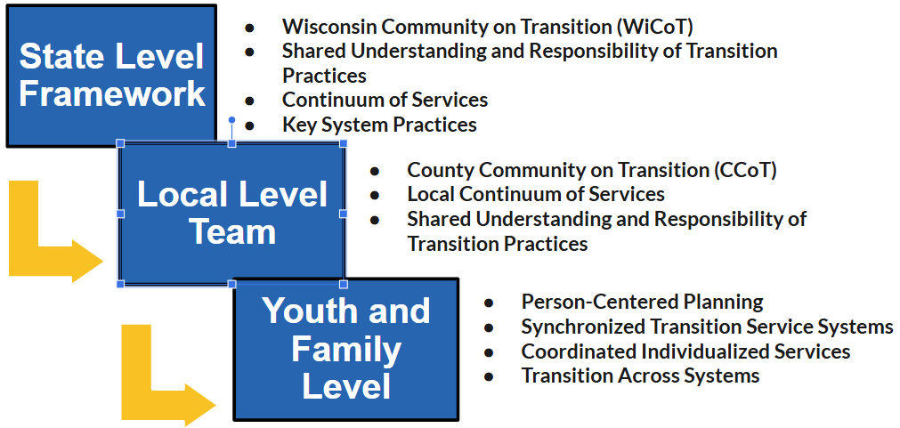
Wisconsin Pathways to Transition Partnerships
Notes:
Wisconsin’s Pathways to Transition Planning is a framework that operates across three interconnected levels—state, local, and individual—each playing a critical role in supporting positive outcomes for youth with disabilities.
At the state level, the Wisconsin Community on Transition (WiCoT) helps guide the work by promoting a shared understanding and responsibility for transition practices. This level focuses on establishing a statewide continuum of services and encouraging key systems to align their practices in support of effective transition planning.
At the local level, County Communities on Transition, or CCoTs, work to apply these shared understandings within their own communities. These teams collaborate to strengthen the local continuum of services and ensure that transition practices are understood and implemented across schools, agencies, and other community partners.
Finally, at the youth and family level, the focus is on person-centered planning that honors each young person’s unique goals and needs. This includes synchronizing transition services across systems, coordinating individualized supports, and ensuring that services are seamless as students move from school to adulthood.
Together, these three levels create a strong, connected foundation for effective transition planning in Wisconsin.
Together, these three levels create a strong, connected foundation for effective transition planning in Wisconsin.
However, as we explore how the pathways connect from the state level, to the local level, to the youth and family level, we often find that the flow of information isn’t always seamless. There may be areas where communication or coordination gets interrupted. This is something we want to acknowledge and reflect on together, as it offers insight into where our efforts could be strengthened.

Slide 9
Reflecting on Our CCoT Process
What’s working well?
  Celebrate successes and achievements in transition planning.
What strategies have been most effective?
  Share specific examples that have helped move the work forward.
What challenges have we faced?
  Identify barriers that may be limiting progress or collaboration.
Where might there be disconnects?
  Reflect on gaps or misalignment between transition partners.
Are we moving toward our goals?
  Consider progress and areas where we may need to adjust.
Notes:
This slide is an invitation for honest, open reflection on our work as a CCoT team. Let’s begin by thinking about what’s going well or what has gone well in the past. What successes have we seen in our transition planning efforts? Are there moments, practices, or outcomes we can celebrate?
Next, let’s reflect on the strategies that have helped us achieve those successes. These can be specific actions, routines, or partnerships that have made a meaningful difference.
At the same time, we know there are likely challenges that have gotten in the way. Let’s take a moment to name the barriers we’ve encountered, whether it’s been about time, capacity, communication, or something else. Naming these challenges helps us understand where we need support or change.
We’ll also take a look at any areas where there may be disconnects between partners. Are we all working from the same understanding? Is there misalignment that we need to talk through?
Finally, let’s consider our overall progress. Are we making strides toward the goals we’ve set as a team? And if not, what might we need to rethink or do differently moving forward?
This reflection helps ground us in our current reality—and it sets the stage for purposeful planning as we move through the RESET process.
🌟 Activity: CCoT Reflection Gallery Walk (In Person) / Jamboard Walk (Virtual)
Goal: Reflect on what’s working, what’s challenging, and where growth is needed.
Setup:
Create five posters or flip chart sheets (in-person) or five Jamboard/Google Slides frames (virtual) labeled:
What’s Working?
Effective Strategies
Challenges
Disconnects Between Partners
Progress Toward Goals
Instructions:
Give team members sticky notes (physical or virtual).
Invite them to move around the room or through the digital board, adding their thoughts to each prompt.
After 10–15 minutes, return as a group and review each section together.
Identify themes, surprises, or areas that spark discussion.
Follow-Up Questions:
What patterns are we noticing?
What can we celebrate?
What should we prioritize addressing?
🔄 Activity: Stop – Start – Continue Reflection (In Person or Virtual)
Goal: Evaluate team practices to improve CCoT collaboration and effectiveness.
Instructions:
Ask each participant to independently respond to these three prompts:
What should we stop doing as a team?
What should we start doing to improve our process?
What should we continue because it’s working well?
In small breakout groups or table groups, have participants share and discuss their ideas.
Use a shared document, chart paper, or collaborative slide to gather responses.
Debrief as a full group and highlight priorities that emerged.
🔍 Activity: CCoT Connection Mapping (Great for Teams That Are Struggling with Disconnects)
Goal: Visualize how well-connected transition partners feel and identify gaps.
Instructions:
Ask each participant to draw or describe their perception of how connected different transition partners are on the team (school, DVR, family, etc.).
For virtual meetings, use a shared slide deck or whiteboard tool for everyone to mark connections (e.g., strong, weak, missing).
Facilitate discussion around:
Where do connections feel strong?
Where are there gaps?
What would strengthen communication and collaboration?

Slide 10
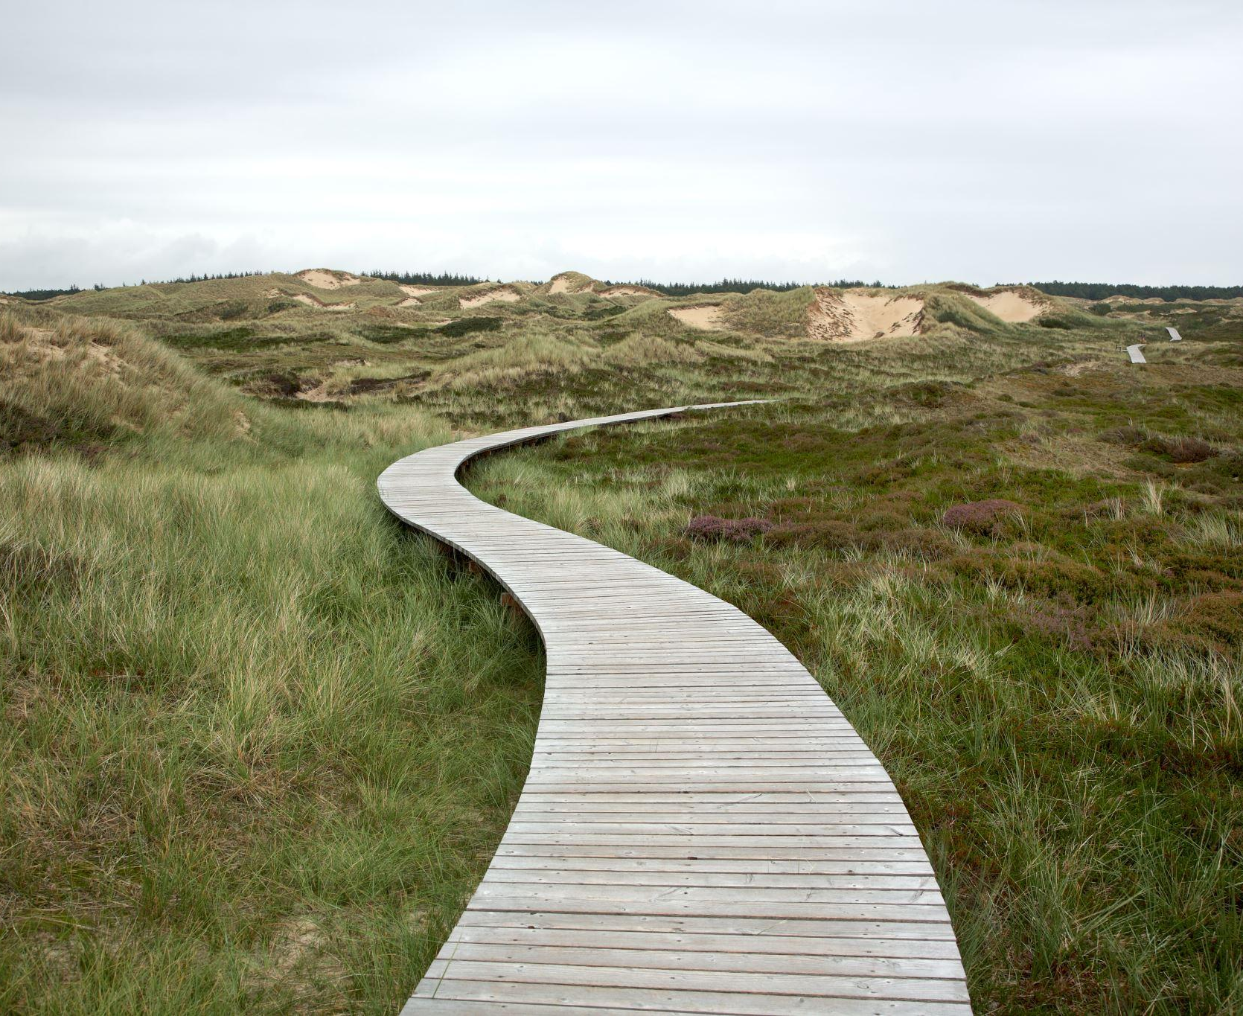
Summary and next steps
Add a summary of today's meeting
Notes:
Add your summary of today on this slide to reflect and determine next steps and to share at our next meeting

Slide 11
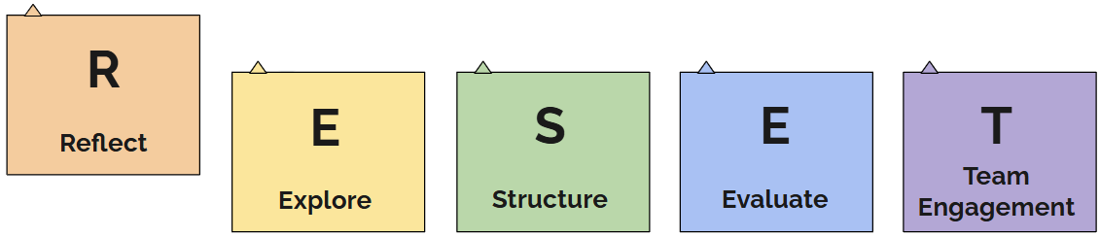
CCoT RESET - Reflect
Notes:
Today we will focus on reflect in the process of RESETing our CCoT Team. This begins with the foundational values as a CCoT.

Slide 12
Objectives:
Reflect on and evaluate the team’s current vision, mission, and purpose statements.
Or Create the teams vision, mission, and purpose statements.
Align individual and collective team roles with these guiding statements.
Identify necessary adjustments to ensure the statements reflect current needs and commitments.
Notes:
Our objectives for today's meeting are: Read slide

Slide 13

CCoT Vision
Vision:
If we achieved this outcome, success would look like...
I see my role and contributions aligning with the CCoT vision statement in the following way(s)...
Notes:
What Is a Vision Statement?
A vision statement describes our long-term goal and what success looks like for our team. It paints a compelling picture of where we're headed and what we hope to accomplish together. It should inspire, align, and stretch us.
Below are two options:
1. Creating a New Vision Statement
2. Revisiting an Existing Vision Statement
🔮 VISION STATEMENT PROCESS
✅ FOR TEAMS CREATING A NEW Vision Statement
1. Guided Visualization (5–7 min)
Prompt: “It’s the year 2031. Your CCoT has made incredible progress…”
Invite quiet reflection with these questions:
What do you see happening in your community?
What do you hear from students, families, and partners?
What does success feel like?
2. Small Group Vision Scenes (15–20 min)
Each group answers:
“If we achieved that outcome, success would look like…”
“What would people be doing differently?”
“What systems or habits would be in place?”
“What mindsets would have shifted?”
Output can be diagrams, phrases, or short descriptions.
3. Whole Group Share-Out + Theme Capture (10–15 min)
Facilitator charts key values, words, or recurring themes under a heading:
“What Our Future Looks Like”
4. Drafting the Vision (Optional – or schedule follow-up)
Bridge Question:
“If this is the future we envision, what words or phrases capture where we are headed as a team?”
Draft collaboratively using:
“Our vision is that…” or “We envision a future where…”
🔁 FOR TEAMS WITH AN EXISTING Vision Statement
1. Read + React (5 min)
Display and read the vision statement aloud.
Ask:
“What stands out to you?”
“What emotions or images does it evoke?”
Write down short reactions.
2. Silent Vote: Alignment Check (5 min)
Scale:
0 = Doesn’t fit us anymore
3 = Somewhat true, needs work
5 = Still inspiring and accurate
3. Guided Discussion (15–20 min)
Reflect:
What still feels powerful?
What needs updating or clarification?
Does this still stretch us toward a bold future?
4. Decide: Reaffirm, Refresh, or Rewrite (5–10 min)
✅ Keep as-is
✏️ Make small updates (assign editor)
🌀 Begin fresh (use "New Vision" steps above)

Slide 14

CCoT Purpose
Purpose:
Our team exists for/to...
If our team were to achieve one impactful result this year, it would it be...
Our purpose motivates me to keep showing up because/to...
We know we're making a difference when...
Notes:
Our purpose statement provides clarity, direction, and inspiration for our team guiding us in our work moving forward. The purpose describes the deeper why behind our collaboration.
Activity
Below are two options
Creating a New Purpose Statement
If a purpose already exists
Creating a New Purpose Statement: Preparation:
Post four large chart papers around the room, each with one of the following questions written at the top (also included on the slide):
Our team exists for/to...
If our team were to achieve one impactful result this year, it would be...
Our purpose motivates me to keep showing up because/to...
We know we're making a difference when...
Provide each participant with a set of sticky notes and a marker.
Activity Steps:
1. Individual Reflection (Sticky Note Brainstorm)
Display the slide with the four purpose questions.
Read each question aloud and ask participants to reflect individually.
Have them write their responses—one idea per sticky note.
2. Gallery Walk
Invite team members to walk around the room and place their sticky notes on the corresponding chart paper.
Encourage them to read others’ responses as they go.
Facilitator reads the slide questions again aloud for grounding.
3. Star What Resonates
Once everyone has posted their responses, ask participants to revisit each chart.
Using a marker or star sticker, place a star next to any idea(s) that strongly resonate with them.
4. Small Group Theme Analysis
Divide the team into 2–4 small groups.
Assign each group one of the four chart paper questions.
Ask groups to:
Identify common themes, repeated words or ideas.
Highlight or discuss items with the most stars.
Draft a potential purpose or “essential intent” statement based on the patterns they observe.
5. Whole Group Discussion
Bring everyone back together.
Each group shares their drafted statement.
As a team, collaborate to refine and synthesize ideas into one collective purpose or intent statement that complements the broader mission and vision.
6. Share and Affirm
Share the final draft of the purpose/intent statement with the full group.
This can happen immediately or be finalized at a follow-up meeting if more time is needed for review or feedback.
7. Individual Commitment
Ask each participant to reflect and share:
“What is one way I can personally contribute to our newly defined purpose?”
If a Purpose Statement Already Exists:
Review the current purpose statement as a group.
Decide together whether to:
Keep it as is,
Tweak or enhance it,
Or engage in the full activity above to create a new statement.

Slide 15

CCoT Mission
Mission:
The change we want to see in our community because of our work is...
We can work together to serve our youth with disabilities by...
Notes:
The purpose of a mission statement is to clarify our purpose, guide decision making, set us in a direction for our work, align our work, to guide our growth in transition planning for the county. Simply stated it is WHAT the team DOES, FOR WHOM and HOW. Review the team's current mission statement. Read the slide… Ask the prompting questions. Consider breaking team into small groups to discuss the questions and report out to the larger group.
Below are two options:
1. Creating a New Mission Statement
2. Revisiting an Existing Mission Statement
🎯 MISSION STATEMENT PROCESS
✅ FOR TEAMS CREATING A NEW Mission Statement
1. Quick Write: “The Change We Want to See” (5 min)
“The change we want to see in our community because of our work is…”
Each person writes on a sticky note or card. Share round-robin.
2. Quick Write: “How We’ll Make That Change” (5–7 min)
“We can work together to serve youth with disabilities by…”
Capture verbs and key actions (e.g., “connecting,” “educating,” “advocating”).
3. Connect the Dots (5–10 min)
Bridge Question:
“If this is the change we want to see, and these are the ways we work—how would we describe what our team does, for whom, and how?”
4. Drafting the Mission Statement (10–15 min)
Use this sentence frame:
We [do what], for [whom], by [how].
Example:
“We coordinate education and community partners, for youth with disabilities, by building inclusive systems and strong family partnerships.”
🔁 FOR TEAMS WITH AN EXISTING Mission Statement
1. Review + Reaction (5 min)
Read it aloud. Ask:
“What resonates? What feels outdated or vague?”
Everyone jots a few thoughts.
2. Alignment Check (Sticky Note Voting – 5 min)
Scale:
0 = No longer fits
3 = Somewhat accurate, needs edits
5 = Still clearly guiding our work
3. Group Discussion (15–20 min)
Prompts:
Does this clearly state what we do, for whom, and how?
Does it reflect our current work and growth goals?
Are there missing elements?
4. Decision Point (5–10 min)
✅ Keep it
✏️ Edit lightly (assign editor)
🌀 Recreate using “New Mission” steps above

Slide 16
Vision Statement:
Mission Statement:
Purpose Statement:
How do our vision, mission, and purpose statements work together to create a clear path for improving transition outcomes for students with disabilities?
In what ways can aligning these statements strengthen our team’s collaboration and commitment to ensuring every student’s successful move to adulthood?
Notes:
Activity Instructions: Reflecting on Our Vision, Purpose, and Mission
Display the Statements:
Copy and paste your team’s Vision, Purpose, and Mission statements onto the slide.
Silent Review:
Ask each team member to carefully read and reflect silently on all three statements for a few minutes.
Written Reflection:
Provide each person with post-it notes and ask them to write brief responses to the following questions (displayed on the slide):
How do our vision, mission, and purpose statements work together to create a clear path for improving transition outcomes for students with disabilities?
In what ways can aligning these statements strengthen our team’s collaboration and commitment to ensuring every student’s successful move to adulthood?
Group Share and Discussion:
Invite team members to share their insights. Collect and summarize the key themes.
Follow-up and Action Planning:
Agree on any next steps or follow-up actions to help strengthen alignment and support the team’s work moving forward.
The CCoT facilitator or designated team members takes all notes and finalizes the vision, purpose, and mission statments

Slide 17

Activity
Quick Poll/Survey (Live or Paper):
On a scale from 1–5, how well do you understand the vision of a CCoT?
On a scale from 1–5, how well do you understand the purpose of a CCoT?
On a scale from 1–5, how well do you understand the mission of a CCoT?
Notes:
Do we need or can we move the activity from 16 to this?
For 13/14/15 do we keep the activities in the notes or do we create a resource with them? Easier to access?

Slide 18
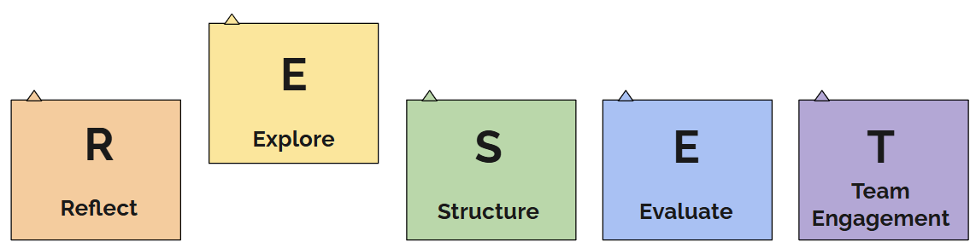
CCoT RESET-Explore
Notes:
Next we will look at how do we gather more information about our priorities.

Slide 19
Objectives:
Assess the current representative voices across education, families, agencies, and community partners.
Identify gaps in team membership and engage missing partners.
Clarify expectations and roles across the team.
Analyze local community barriers and strengths in transition planning
Establish next steps to align the team’s structure.
Notes:
Our objectives for today's meeting are: Read slide

Slide 20


Where Are We As A Team Now?
Does our team have a diverse team with representation of secondary educators, youth and their families, services systems, and community-based organizations?
Notes:
As we continue our RESET, this is a time to pause and truly explore who is at the table. Do we have representation from across all components of transition including: secondary education, youth and their families, agencies, post-secondary education and community organizations? Diversity in voices and experiences ensures we’re not only meeting compliance requirements, but also responding to the real needs of the youth and families we serve. Let’s reflect honestly: who is consistently present and contributing, and who is missing? This will guide us as we think about rebuilding or strengthening our team.

Slide 21

We Know We Have Representation When...
We identify representatives from various backgrounds and expertise to bring a wide range of perspectives to our team
We use multiple methods to invite and hold CCoT Team meetings to ensure all team members can attend and actively engage in our work.
We hold regular meetings that include active participation from secondary educators, service system representatives, families, youth, and community- based organizations.
We collect and act on feedback from team members to continuously improve our collaborative efforts and ensure that all voices are heard.
Notes:
This slide shares adult practice statements or "We Statements" that can help us assess how inclusive and balanced our CCoT team currently is. If you can confidently say "yes, we do this" to these, it’s a sign that our team is structured for engagement across multiple partners. If not, that’s okay, this is why we’re here and doing this work. This RESET is an opportunity to realign and recommit. These statements are not about judgment but about clarity and next steps.

Slide 22

Activity
Recreate Your CCoT Team
Create a document which includes:
Current CCoT members
Missing key transition partners (based on our vision, purpose, and mission)
Identify which current members have a connection to the missing partners
Reach out to invite them using a shared message.
Resource highlight: ​
Sample Special Education Director Email​
Sample Service Systems or Community Organizations
Notes:
The goal of this activity is to visually map your current team, name what voices are missing, and identify who can build those bridges. You don’t need to do it all at once—but you can start by extending one or two intentional invitations.
Below are sample emails your team can utilize to invite others.
Sample email to service systems or community organizations
Subject: Invitation to Attend INSERT COUNTY HERE County CCoT Meetings Dear [Recipient], We invite you and your transition partner staff to attend the INSERT COUNTY HERE County Community on Transition (CCoT) meetings this year. Our goal is to have representation from each partner that supports youth and their families in the transition process. What is CCoT The INSERT COUNTY HERE CCoT is a group of transition partners working together to: ● Identify barriers to effective transition planning. ● Build new relationships and increase collaboration, leading to improved post-school outcomes. ● Develop pathways to employment, education/training, and independent living. Why Agency Involvement Matters Agencies play a vital role in transition planning because they: ● Bring expertise and resources to support youth and their families. ● Provide critical insights into community-based supports and services. ● Foster collaboration with schools, community organizations, and employers to align efforts. ● Help bridge service gaps and ensure a smooth transition to adulthood. ● Keep students and families informed of available resources and opportunities. Upcoming Meeting Details Date: [Insert Date] Time: [Insert Time] Location: [Insert Location or Virtual Link] By participating in the CCoT, transition partners strengthen collaboration, align resources, and help ensure students with disabilities receive the support they need for a successful transition to adult life. We hope you’ll join us or send a representative to our next meeting. Thank you for your consideration. Please feel free to contact me with any questions. Warm regards,
Sample email to a special education director
Subject: Invitation to Attend INSERT COUNTY HERE County CCoT Meetings Dear [Recipient], We invite you and your special education staff to attend the INSERT COUNTY HERE County Community on Transition (CCoT) meetings this year. Our goal is to have representation from each district and partner that supports youth and their families in the transition process. What is CCoT The INSERT COUNTY HERE CCoT is a group of transition partners working to: ● Identify barriers to transition planning. ● Create new relationships and increase collaboration resulting in successful post-school outcomes. ● Create pathways to employment, education/training, and independent living. Why School Staff Involvement Matters Schools are critical in transition planning because they: ● Serve as the first point of contact for students and families. ● Foster collaboration with agencies, organizations, community members, and employers to align goals. ● Provide insights into postsecondary outcomes and address service gaps. ● Ensure all students are represented and receive equitable support. ● Can stay informed with up-to-date information and resources. Upcoming Meeting Details Date: [Insert Date] Time: [Insert Time] Location: [Insert Location or Virtual Link] Participating in CCoT strengthens collaboration, aligns resources, and ensures students with disabilities receive the support they need for postsecondary success. Please consider joining us or sending a staff member to our next meeting. Thank you for your consideration. Please feel free to contact me with any questions. Warm regards,

Slide 23

Team Member Expectations and Collaboration
What do we expect from each other as members of the CCoT?
How do we stay informed and follow through?
How do we communicate between meetings?
What does shared responsibility look like?
Resource highlight: ​
Co-creation Mindset Card
Notes:
As we strengthen our team, it is important to clarify expectations in a way that promotes trust and shared accountability. Ask your team: What does participation look like? How do we want to communicate? Who owns follow-up tasks, and how do we make space for shared leadership? These conversations help teams feel grounded and build a sense of mutual responsibility. You might consider utilizing the co-creation mindset card as an activity.

Slide 24

Our Local Community
What barriers to transition are most pressing in our community?
~ Do you have data to support this?
Where is the disconnect between partners?
~ What steps will we take to prioritize barriers?
What celebrations in transition are most obvious?
Have a common understanding of data: Are we making assumptions, or do we have data to back this up?
Notes:
It is essential to ground our planning in our community’s point and time. This slide is about reflecting on what we know, not just what we assume. What data do we have, and what does it tell us about barriers? Are there disconnects in how partners work together or share information? Is there a drop-off between school services and adult service/supports? Are groups being left out? At the same time, let’s recognize and celebrate what’s going well. Both insights and celebrations will guide the way forward. Consider our mission, vision, and purpose, how do the needs and strengths of your community align with those?

Slide 25

Exit Reflection: Explore
Based on what we’ve explored today, what is one thing we want to strengthen in our team?
What is one action we will take before the next meeting?
Notes:
As we wrap up this section, take a moment to reflect. What stood out for you today? What did you learn about our team’s make-up, voice, or reach? These questions are meant to support forward momentum.
Capture responses in a shared doc, in the chat, or even on a piece of paper as people leave for the facilitator to collect. Small steps forward often start with one clear intention.

Slide 26
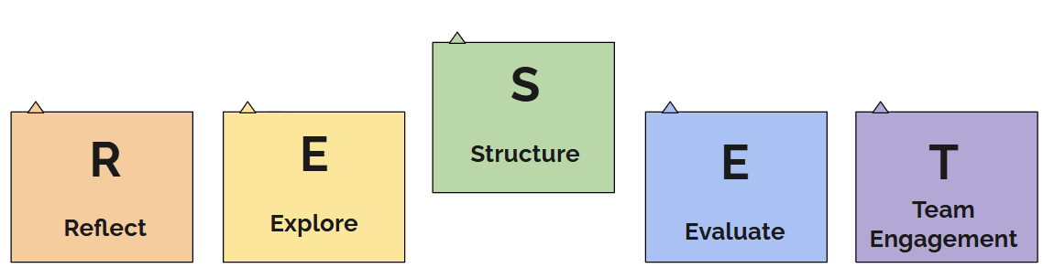
CCoT RESET - Structure
Notes:
In this section, we’re taking a step back to look at the foundation of how we work together as a team.

Slide 27
Objectives:
Evaluate current team structure, cadence, and membership.
Explore strategies to improve meeting effectiveness, accountability, and team sustainability.
Clarify roles and expectations for all team members.
Notes:
Our objectives for today's meeting are: Read slide
In this section, we’re taking a step back to look at the foundation of how we work together as a team. Just like a strong building needs a solid frame, an effective CCoT needs intentional structure. This includes how often we meet, the roles we hold, and how we communicate and follow through on actions. Our goal is to walk away with a clearer understanding of how to strengthen our team’s structure so it supports consistency, shared responsibility, and meaningful progress in our transition efforts.

Slide 28

Structuring Meetings for Efficiency
Cadence of Meetings
Monthly
Bi-monthly
Quarterly
Predictable Schedule
Consistency: Establish a regular schedule (e.g., first Wednesday of the month at 3 PM).
Flexibility: Offer occasional adjustments or alternative times to meet the needs of all members.
Notes:
One of the most impactful ways to support team sustainability is by us having a predictable and inclusive meeting schedule. Whether we meet monthly or quarterly, consistency will help us plan ahead and commit. At the same time, we know flexibility matters, especially for partners with competing priorities or varied schedules.
Consider setting up a zoom poll, or in person votes to determine cadence of meetings, and schedules

Slide 29

Team Structure Continued
Types of Meetings
Whole Team Meetings: All team members meet as one team.
  Face-to-Face: Best for setting goals, tackling challenges, and building relationships.
  Virtual: Ideal for quick check-ins or updates.
  Hybrid: Virtual and/or Face-to-Face combined
2 Option Meetings: Core/Business Meetings:
Core Meetings: Extended sessions for deep planning and collaboration.
  Suggested Format - Face-to-Face: Best for setting goals, tackling challenges, and building relationships.
Business Meetings: Focused, shorter sessions for updates and decisions based on Core Team planning.
  Suggested Format - Virtual: Ideal for quick check-ins or updates.
    Core Team Members attend both Core Meetings and Business meetings
Notes:
Just as we think about frequency, it’s important to consider the type of meeting we’re holding. Not every meeting needs to look the same.
As we consider types of meetings, let's look at the types of meetings defined on this slide.
Business meetings are virtual check-ins that can help maintain momentum and continue to hear all voices.
Core meetings are in-person meetings that are designed for building relationships and solving complex challenges and carrying out action plans brought about by the full team.
This strategy will meet all team members where they are at while hearing all voices.
Ask team members what type of meeting they can commit too based on the definitions provided.

Slide 30

Defining Roles & Responsibilities
Facilitator/Co-Facilitators: Guide the team through the agenda and meeting goals.
Timekeeper: Monitor pacing to stay on track.
Note Taker: Capture key takeaways, decisions, and next steps.
Process Observer: Reflect on group dynamics and meeting flow based on meeting collective commitments. Ensure all voices are heard.
Big Ideas Capturer: Summarize major insights to share with administrators/Supervisors or absent partners.
Liaison: All take back information to district, service system, community organization etc...
Notes:
Strong teams thrive when everyone has a role. Defining and rotating meeting roles promotes shared responsibility and boosts engagement. All members of the team have the role of being a liaison to share information back to district, service system, community organization etc...… It also helps prevent burnout and overload when responsibilities are spread out. Is anything missing that will help us work better together?
Consider creating a rotating schedule and have team members sign up for a role. Note: This may not work for the role of a facilitator/co-facilitator- but have that discussion of how that may look to assure consistency in the meeting and team structure.
Possible Additional Role: Data coordinator
Idea to help with Big Idea (Could do at the end of meeting)
1 decision we made
1 action step we are working on
1 question to ask our team when we share out to them
Report Out
What feedback did they get on last meeting Big Idea?
What updates do they need to pass along? (not events, etc... but related to our priorites) - can you have a separate way to share events, etc...
Have a standing agenda item (Create at end, Report Back at beginning)

Slide 31
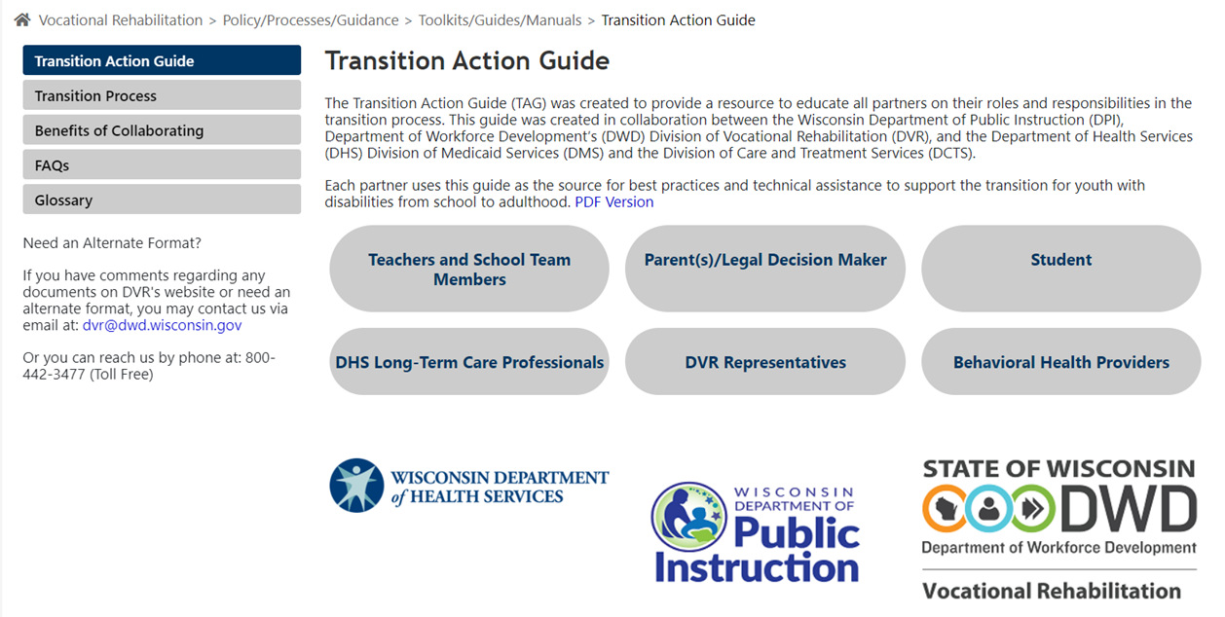
Defining Roles & Responsibilities-
Transition Action Guide
Notes:
Review the Transition Action Guide (TAG) as a group. This resource also helps define roles and responsibilities for transition planning in general.

Slide 32

Co-Creating Agendas For Action-Oriented Meetings
Structure agendas to support engagement and decision-making.
Structure agendas to align with our priorities
Use strategies to keep meetings focused, inclusive, and goal-driven.
Leave time for reflection, next meeting agenda items, and next steps.
Notes:
The agenda sets the tone for our meetings. When team members help create it, they're more invested in the outcomes. A strong agenda includes time to share updates, discuss data or action steps, and close with a summary or reflection.
When creating agendas together, consider Including time for decision-making to ensure meetings lead to progress, not just discussion.
Always end with clear next steps so momentum continues between meetings. This also provides team members to be prepared for the next meeting.
Possible Activities:
First steps to not overwhelm:
Preview agenda and invite input (Is there anything we're missing that's important to your agency or role?)
Start with a Liason Report out (Feedback from Big Ideas, updates or small wins)
Post-It Parking Lot (write topics or questions that haven't come up or don't fit current agenda)
Meeting Reflection (What would make our next meeting even more useful for you?)
Introduce co-creation (What would it look like if we started building agendas together? How could we begin?)
If ready, A good starting point may be to co-create a pre-list of required/consistent agenda items (like Liason Report Out, Big Ideas, Next Steps, Learn About (agency or schools or other) etc..
Individual Brainstorm
Group & Cluster
Prioritize

Slide 33

Activity
Team Structure
Team Structure Self-Assessment:
Use a checklist to compare your current vs. desired meeting formats, roles, and frequency.
Role Assignment Simulation:
In small groups, assign roles (facilitator, note taker, process observer).
Simulate a short (10-minute) meeting to practice shared responsibility.
Meeting Map Visual Design:
Sketch your ideal team meeting structure: format, frequency, flow, and agenda rhythm.
Notes:
Let’s put our ideas into action. These activities give our team a chance to reflect on your current structure and imagine what’s possible. The self-assessment provides a space to identify gaps or areas for improvement. T
he role simulation encourages hands-on practice
the visual meeting map helps you design a system that works for your team. Whether you’re building from scratch or fine-tuning an existing structure, this is your chance to shape your ideal team rhythm.
Develop for teams these resources to utilize
1. Team Meeting Self-Assessment Checklist
Instructions: As a team, review each item and mark whether this is currently in place, needs improvement, or is not yet in place. Use this to spark discussion and set priorities.
Element
In Place
Needs Improvement
Not in Place
Notes/Next Steps
min
Action Planning
Facilitator
5 min
Reflection & Wrap-Up
Process Observer
Next Meeting: [Insert Date & Time]
Roles for Next Meeting: [Assign or Rotate]
4. Ideal Meeting Structure Visual Map
Instructions: Use the space below to sketch your team’s ideal meeting flow. Include frequency (e.g., monthly), type of meetings (business, core, virtual), typical agenda sections, and role use.
(Draw your ideal structure or use shapes/arrows to create a "map")
[Monthly Business Meeting] ---> [Quarterly Core Meeting] ---> [Annual Goal Setting]
[Virtual Check-ins] --> [Face-to-Face Planning Days]
Agenda Flow:
Welcome > Updates > Key Discussion > Decisions > Wrap-Up
(Use blank space below for drawing or sticky note planning)
Alternate activities:
Three-Column Sort:
Create three columns:
Keep (What’s working in our structure?)
Change (What’s not working?)
Start (What would help us function better?)
Have small groups brainstorm and then share out.
One Wish
Ask each person to finish the sentence:
“If I could change one thing about how our team is set up, I would…”
This works great as an anonymous input or sticky note wall.
Who Does What?
Have each person write their name/agency on a sticky notes and place them under categories like:
Connects to Youth or Families
Who brings real voices and experiences into the room?
Who takes information directly to youth families?
Liason to an Agency or School
Who is expected to take info back or bring info from agency/school/other?
Implements or Supports Services
Helps with planning/action steps?
Who can take action based on the team’s decisions?
Uses Data or Brings Insights
Who shares information that helps us make smart decisions?
Follows Up on Team Decisions
Who makes sure the team’s plans turn into action?
Lifts Underheard Voices
Who helps make sure every student and family is considered?
Engages in Meetings
Who contributes to or leads parts of meetings?
Who attends regularly?
Who helps guide the team’s focus, goals, or follow-through (speaks up)?
Look for gaps or overlaps — is someone carrying too much? Are any roles unclear?

Slide 34
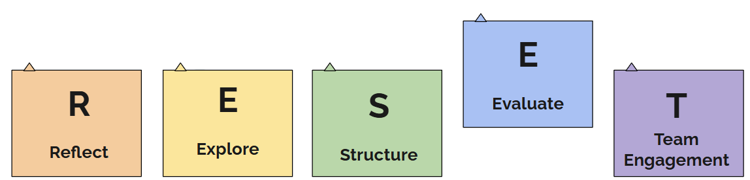
Welcome to the CCoT RESET
Notes:
By evaluating what we learned in EXPLORE we can create FOCUSED & ATTAINABLE action plans.

Slide 35
Objectives:
Use reflection and data to identify strengths and gaps in local transition efforts.
Develop clear action steps based on community needs and existing initiatives.
Strengthen engagement through shared leadership and continuous communication.
Notes:
Our objectives for today's meeting are: Read slide
In this section, we will focus on how our team can evaluate our current transition planning efforts. Evaluation is not only about looking back but also about moving forward. It involves collecting both formal and informal data to identify what’s working and what needs improvement. Once those gaps and strengths are clear, our team can create action steps that align with our existing community needs. Remember, shared leadership and ongoing communication help keep everyone involved, informed, and committed to sustained success.

Slide 36

What is Data?
Types of Data:
  Informal
  Formal
Common Data Points:
  What do we already know?
  How do we measure success?
Notes:
Often we think of data as numbers, charts, etc... but it is more than that!
When we talk about evaluation, data plays a central role. Data comes in many forms — informal data might include feedback from students and families, while formal data might involve graduation rates, employment data, or transition assessments. Both types are valuable. The key is identifying what success looks like for our team and choosing data sources that give insight into our progress.
Let's think about what data we already collect and what else might help paint the bigger picture.

Slide 37
Activity:
What Do We Know vs What Do We Need to Know?
WHAT WE KNOW
What information do we already have about students, services or systems related to our transition priorities?
WHAT WE NEED TO KNOW
What do we still need to learn or understand better in order to take action?
Example:
Employment Outcomes: Only a small number of students have jobs by graduation. (Schools - Indicator 14 data - subgroups)
Employment Outcomes: Families often don’t understand what adult services are available.
  Include celebrations
Example:
Employment: Which students are getting job experiences, and who is being left out? (DVR, YA, Transition Programs, etc.)
Employment: What do families say would help them feel more confident in planning? (Families, students, WI Facets, CLTS, etc.)
  Include celebrations
Notes:
Briefly review the mission, vision, and purpose
Ask: If we really want to make progress on these priorities…what do we already know, and what do we still need to find out?
Bridge to Action Activity – Combining Informal and Formal data
“Which of these ‘need to knows’ are most urgent or doable to investigate?
Activity: Chart Paper Labeled Know/Need to Know
Small group Brainstorm (each group have a color of sticky notes)
Examples: what are we hearing from parents, data say about graduates, are groups being left out, barriers, celebrations
Post to each paper
Gallery Walk (or share-out of each side if combined)
Whole Group: Identify key questions or information to gather.
Ways to gather that information (follow-up)
Surveys
Focus groups
IEP data (PTPs, Case studies, etc.)
Service Mapping
Data Dashboards (DVR, YA, ADRC, etc…)
Narrative feedback from families, community, etc..

Slide 38


Action Planning-Next Steps
Develop a 1-year action plan choosing one activity to focus on
Set benchmarks for quarterly or mid-year check-ins
Define the team focus activity
Determine the actionable items needed for the team to complete the selected activity
Determine how the team will evaluate the activities
Determine which team members will be responsible for each actionable item
Summarize findings from data collected and actions you will take
As a team, determine next steps
Notes:
Now it’s time to put everything together with action planning. Let's start by identifying one activity that our team wants to focus on for the year. Clearly define this activity and outline what steps are needed to accomplish it.
Assign team members to each action step and decide how you’ll measure progress and success. Be sure to set benchmarks to keep the plan on track and allow for mid-year adjustments. The CTIP Action Plan Template is a great tool to organize all of these elements and align your plan with state-supported structures. See attached template.

Slide 39

Thinking Beyond Events-Sustaining Impact
How do we ensure our work leads to real outcomes for youth?
  Educate your Team of Educators, Service Systems, and Community Organizations
Strategies
Initiative Mapping
Community Mapping
Educator Outreach
Speakers
Transition Event
Notes:
It's easy to focus on events, but our long-term goal is impact. We need to ask ourselves: how are our efforts creating meaningful outcomes for youth? One way to begin is by educating and engaging all team members, including educators, service providers, and community partners. Use tools like initiative mapping (what is already going on in our community such as groups working toward similar goals) and community mapping (what resources are available in our community) to visualize current efforts and identify gaps or duplications. Outreach and training for educators in local districts can expand knowledge and buy-in. Hosting guest speakers can bring new energy and expertise. All of these strategies help move beyond a one-time transition event to continuous growth and results and can help inform a planned transition event.
Events can have an impact; however, are we measuring their impact? What is the "purpose" and does that match our mission, vision and purpose as a team? Which youth/families are we reaching? Is it representative of our county's population of youth with disabilities or is a targeted population? If it is targeted, are we looking at alternative activities to impact other populations? Are we getting feedback from the youth (and families)? Are we getting feedback from the agencies, etc...? And are we using that feedback to guide our practices?

Slide 40

Activity
Action Plan Template:
  Begin filling in team-specific goals, timelines, roles, and benchmarks using a structured planning tool.
  Utilize the Action Planning Template and example to guide your work.
Resource Highlight: ​
Action Plan Template
Example Action Plan
Notes:
This activity helps teams move from theory to action.
Use the example Action Plan Template to begin documenting your goals, timelines, roles, and benchmarks. This process sets the stage for actionable, sustainable change. An example of an action plan could be completing a community or initiative map to capture the current landscape of transition-related efforts.

Slide 41
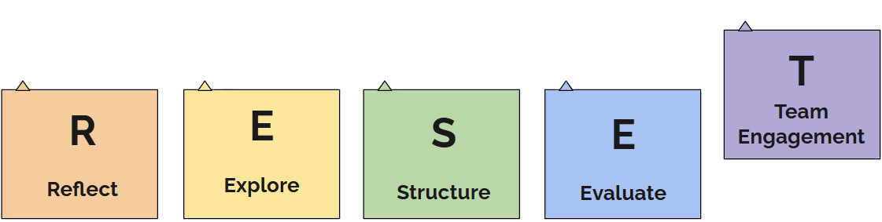
CCoT RESET – Team Engagement
Notes:
In this final section of RESET, we focus on the heart of successful community transition work: team engagement

Slide 42
Objectives:
Strengthen engagement through shared leadership and continuous communication.
Foster a culture of collaboration and inclusivity among all transition stakeholders.
Ensure all voices are valued and represented in the transition planning process.
Notes:
Our objectives for today's meeting are: Read slide
In this final section of RESET, we focus on the heart of successful community transition work: team engagement. Teams function best when there is strong, shared leadership and intentional, ongoing communication. We’ll examine how to maintain momentum, deepen commitment across all transition partners, and create a team culture that values inclusivity, voice, and shared responsibility. These objectives reflect the need to go beyond one-time meetings or events and create structures and relationships that foster lasting collaboration.

Slide 43

How Do We Keep Moving Forward?
Buy-in & Motivation: Clarify the purpose and goals. Why does this work matter?
Engagement Strategies: Maintain strong participation and involvement from all partners.
Effective Communication & Relationship Building: Use regular follow-ups, invite new voices, and cultivate shared leadership.
Notes:
To keep moving forward, it’s essential to regularly revisit and reaffirm why we are doing this work. A shared understanding of our goals fosters motivation. Engagement strategies can include inviting feedback, co-hosting events with different partners, and spotlighting successes. Communication should not be one-directional; it’s about building relationships and ensuring all voices, especially those of youth and families are heard. Shared leadership is also critical: when all team members see themselves as valued contributors, ownership of the work increases, and sustainability becomes possible. This is what our CCoT will strive for.

Slide 44

Activity
Team Engagement Activity
Why does this work matter to our team and community?
How can we increase engagement from:
  Educators
  Youth
  Families
  Other transition partners
How do we maintain involvement over time?
How do we practice and promote shared leadership?
Notes:
This reflective activity is designed to help your team think through how to strengthen and sustain engagement. Consider why this work is meaningful to each stakeholder group and brainstorm concrete ways to enhance their participation. For instance, could a family member co-facilitate a meeting? Can students present their transition stories? Use this time to explore what shared leadership might look like in your team context and how you might shift roles to build collective ownership.

Slide 45

Statewide and Local Resources
Statewide:
  Transition Action Guide
Local:
  CCoT Toolkit (Google Site & PDF Version)
  Community Maps
  Sequence of Services
  Transition Events
  Data Collection Tools
Notes:
There are resources available to support and guide you. At the statewide level, the Transition Action Guide offers structured guidance on agency roles and coordination. Locally, the CCoT Toolkit, available in Google site and PDF formats includes practical tools, templates, and strategies. Community maps, transition event calendars, and data collection tools can also help you stay organized, make informed decisions, and identify service gaps.
Lean into these resources and share them widely with your partners.

Slide 46

Next Step

Slide 47
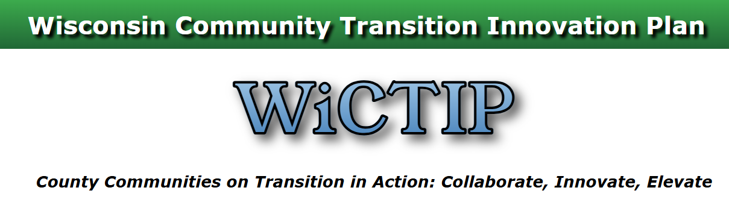
Community Transition Innovation Plan (CTIP)
Data-Based Decision Making
Activity Selection
Action Planning
Adult Practices
Reports
Notes:
As you close out this RESET process, consider utilizing the CTIP online tool as you move forward. This tool provides a pathway to structure your work moving forward. Use your data to guide your decisions, select targeted activities, and build a 1-year action plan. Consider the adult practices that need to shift to better support youth and families. The CTIP also generates reports that help your team track progress and share updates with transition partners. It’s a living document that will evolve with your team’s work and goals.

Slide 48

Thank you

